Slide 1
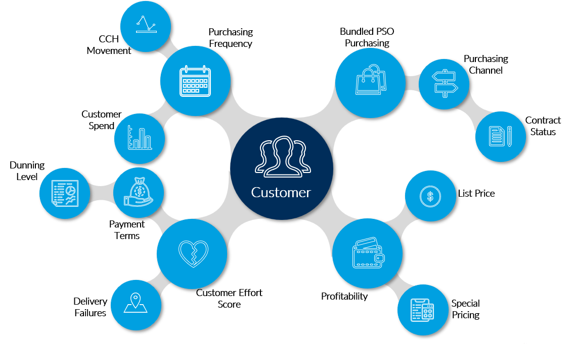
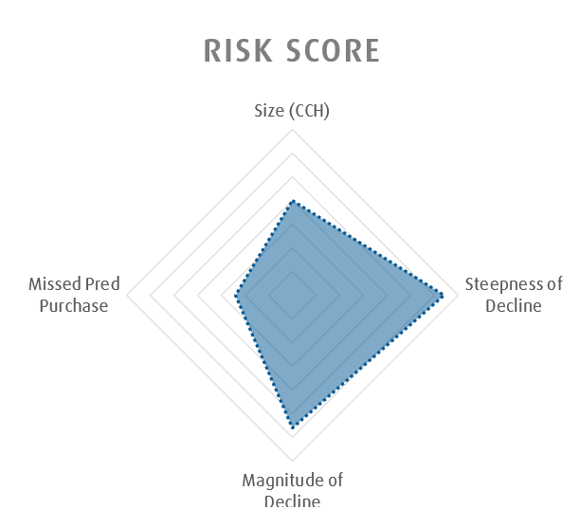
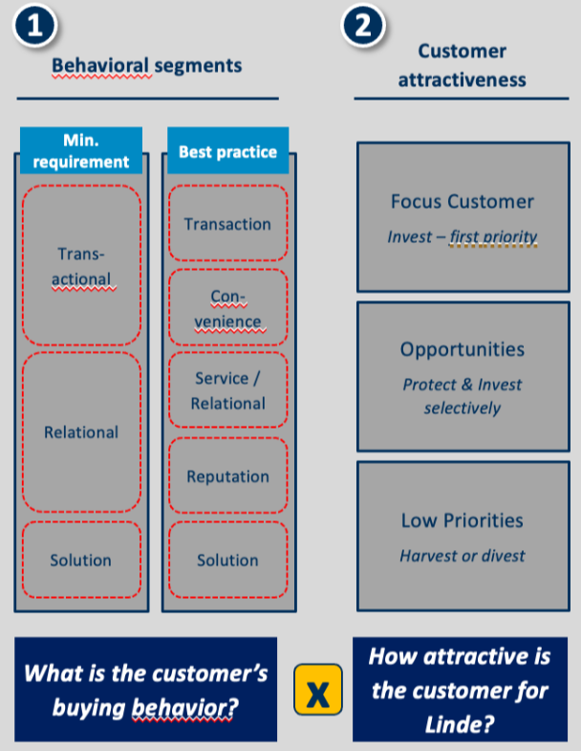
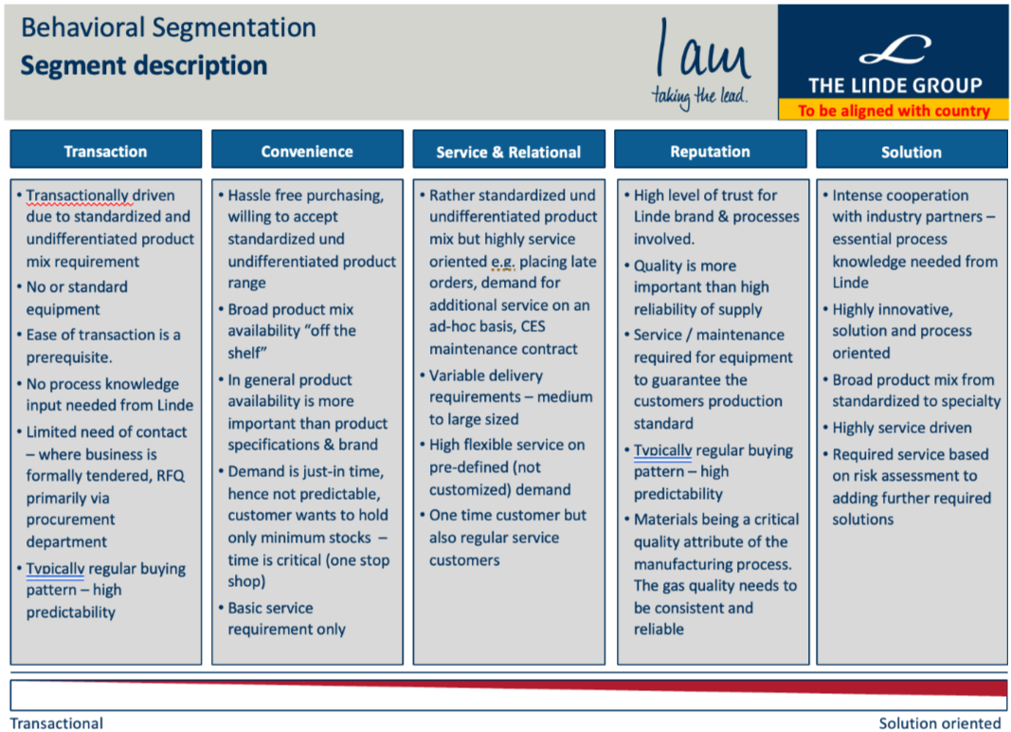
Next Best Action Notes
RSP Action (Jamie) –
Define total RSP Ship to.
286,363 Total Cylinder Ship To’s
54,595 Managed Accounts
231,380 Unmanaged Accounts
30,207 with ABN’s loaded with a further 67,495 unclassified
106,065 – Consumers
Create customer persona to reflect a call to action for the salesperson – Utilising pricing at the relevant data points
Align with what we are trying to measure
APAC Action (Bryce) –
Confirm database and data profiling
Align the model to present to most important action for the customer example price, DIFOT etc .
Refer purchase offers and value add using customer profiling association product model – alternative product offer

Slide 2
Roadmap
Missed purchased
CCH decline
Contact customer
Pricing?
Price increase
Profiling/Segmentation
Marketing
Bundling
DIFOT

Slide 3
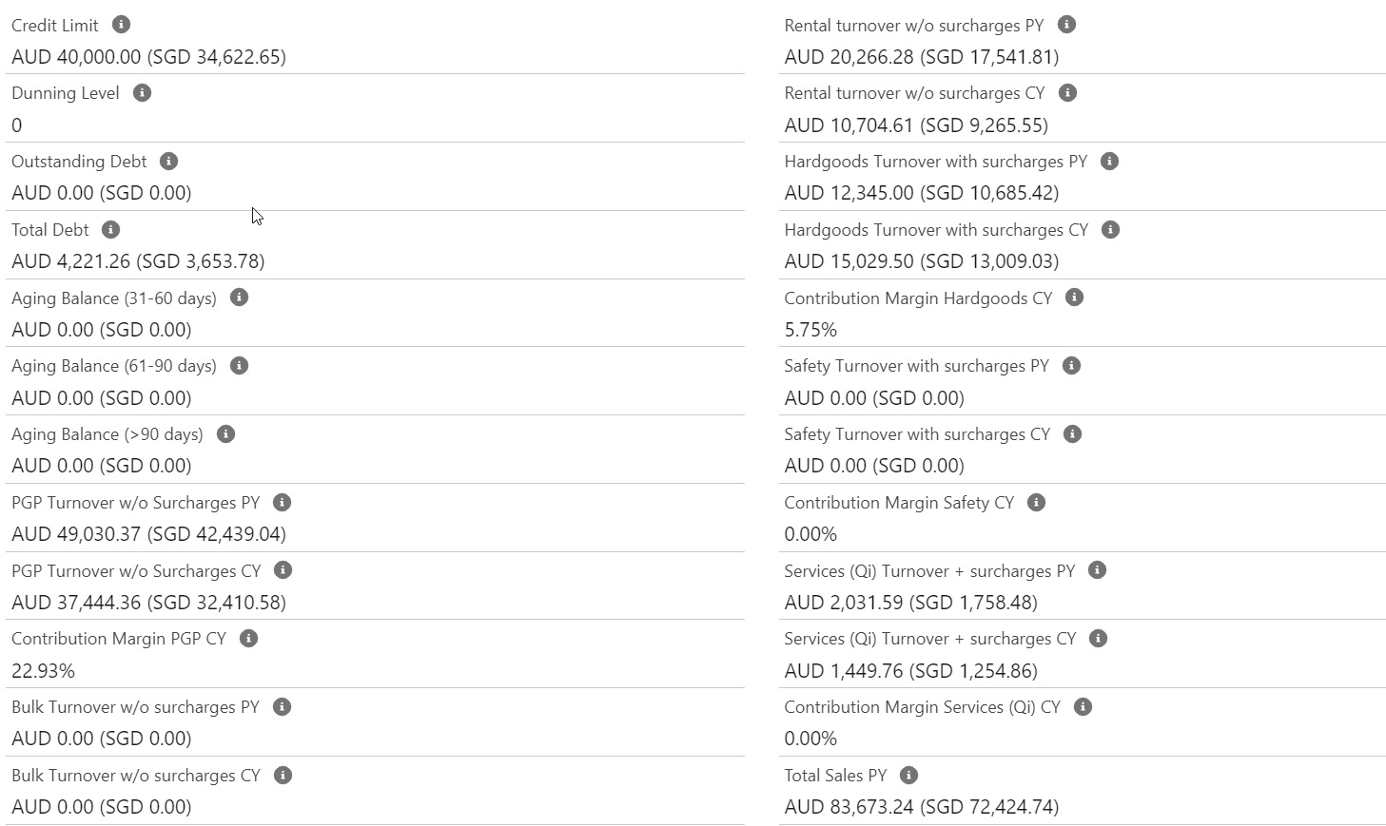
Customer Churn Prediction (Data reqirement)
What we have now | What we might want | Where we can get it?
CCH | Customer feedback
Rental Sales | DIFOT
Delivery | Pricing (contract date* --renewal) (pricing band)
CDA | Contact customer | Salesforce (activity)(events log) workforce potential direct sale rep customer holding dispute/ pricing / product / upsale opp * resolution code (retention)
Industry | Products (associated product by sector)
Product sales
Sales Qty
Rental period (daily/monthly/…)
Plant
Posting period | Possible Sale Actions* output
Holidays

